Slide 1
1. Introduction
Fondamenti di Elettronica
Sergio Spanò – spano@ing.uniroma2.it

Slide 2
Who I am
Sergio Spanò
spano@ing.uniroma2.it
Ingegneria della Informazione
Room B2-10 (2nd floor)
Reception on demand

Slide 3
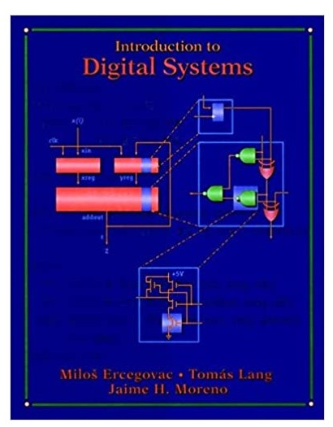
Info about the course
Fundamentals of Digital Electronics
3 CFUs
Written+oral exam
Book: Introduction to Digital Systems - Milos D. Ercegovac, Tomas Lang, Jaime H. Moreno
Digital copies can be found online
Some copies are available at our Library
Hard copies sold by www.libreriaefesto.com
The bookstore is located in San Paolo - Rome

Slide 4
1.1 Introduction

Slide 5
Analog and Digital Electronics
The main task of the Electronic is the processing of signals.
Signal: is a mathematical function that expresses the variation of a quantity (temperature, pressure etc.) with respect to another (usually time).
Analog Electronic: it is based on continuous signals (analog signals) in terms of voltage and/or current.
Digital Electronic: it is based on discrete signals (both on the x and the y axis):
digital signals are often derived by an analog ones;
digitalization of analog signals is performed by three operations: sampling, quantization and coding.

Slide 6
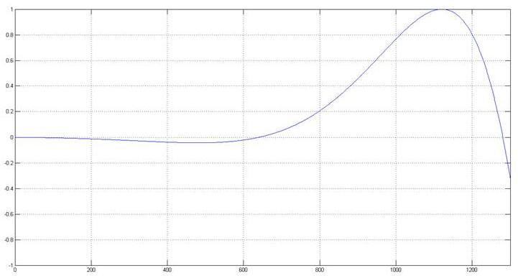
Analog to Digital conversion
Analog signal features:
Signal is defined on the entire x axis
Signal can have any value on the y axis
Both x (time) and y values ∈ ℝ

Slide 7
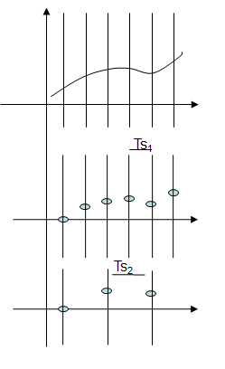
Analog to Digital conversion: Sampling
Sampling: reduction of a continuous signal to a discrete signal.
A discrete signal is obtained considering the values of analog signal only at discrete time
Time between two values (samples) id called Sampling Period.
The inverse of Sample Period is called sample Frequency
Sampling MUST respect the Nyquist–Shannon sampling theorem
Let the highest frequency component, in hertz, for a given analog signal is f_{max}. According to the Nyquist Theorem, the sampling rate must be at least 2f_{max}, or twice the highest analog frequency component.

Slide 8
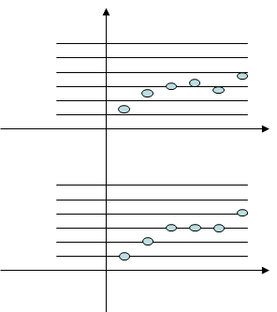
Analog to Digital conversion: Quantization
Discretization of the amplitude.
Y axis is divided in N levels, namely quantization levels
Each sampled value is approximated at the nearest quantization level
The error introduced by the approximation is called quantization error

Slide 9
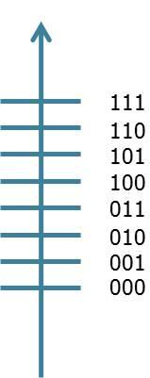
Analog to Digital conversion: Coding
Each quantization level is coded using numbers using a binary representation.
Each number is coded with 0s and 1s (bit).
More bits imply more quantization levels
More quantization levels imply more accuracy
The more bits are used for quantization, the less is the NOISE

Slide 10
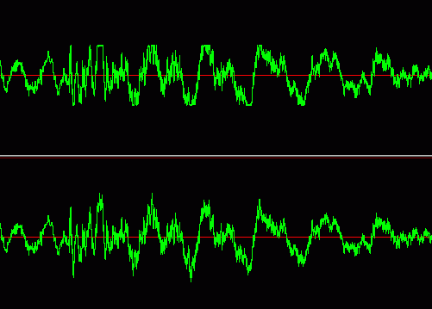

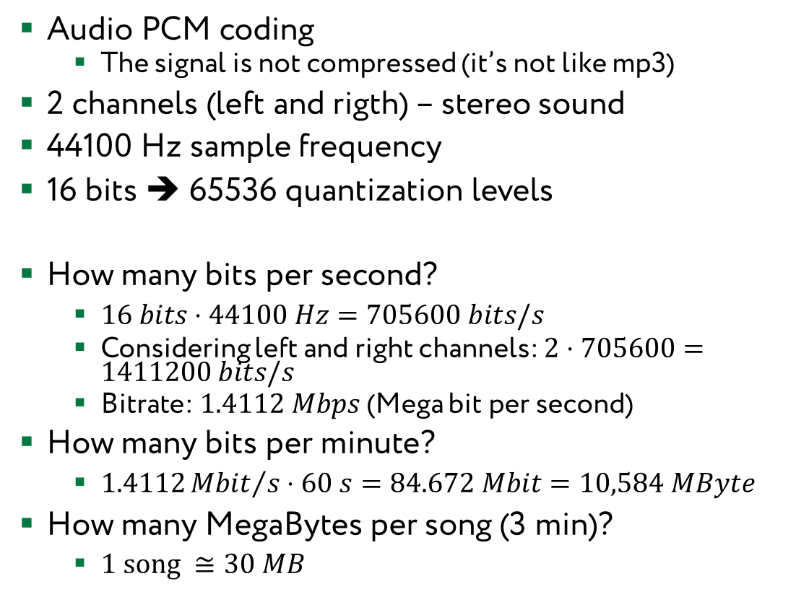
Example: Audio CD
Audio PCM coding
The signal is not compressed (it’s not like mp3)
2 channels (left and rigth) – stereo sound
44100 Hz sample frequency
16 bits ➔ 65536 quantization levels
How many bits per second?
$16 bits⋅44100 Hz=705600 bits/s$
Considering left and right channels: $2⋅705600=1411200 bits/s$
Bitrate: $1.4112 Mbps$ (Mega bit per second)
How many bits per minute?
$1.4112{Mbit}/s⋅60 s=84.672 Mbit=10,584 MByte$
How many MegaBytes per song (3 min)?
$1 song ≅30 MB$

Slide 11
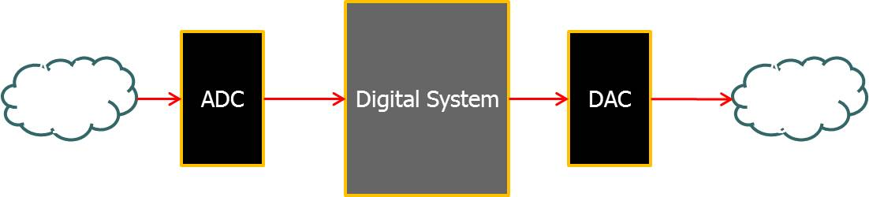
Introduction to digital systems
An electronic system is composed by
Analog IN.
Analog to Digital Converter (ADC).
Digital System (Microprocessor, DSP,FPGA,ASIC).
Digital To Analog Converter (DAC).
Analog OUT.

Slide 12
Why digital?
Noise immunity: continuous signal can be transmitted and reconstructed without errors .
Scalability: in a digital system, a more precise representation of a signal can be obtained by using more binary digits (bits) to represent it.
Reconfigurability: systems implemented on digital devices can be controlled by software
new features can be added without modifying the hardware.
Storage: storage of digital data is easier than analog ones
Integration: digital circuits allow to build very complex circuits in terms of number of components (more than 1,000,000,000 of transistor for a single chip).

Slide 13
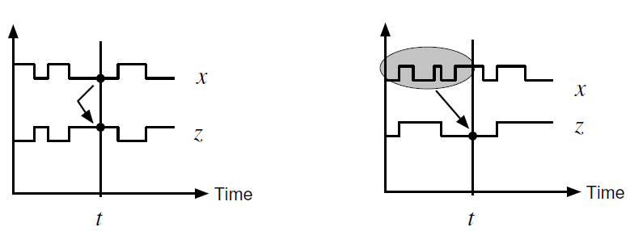
Introduction to digital systems: Digital Systems classification
Combinational Systems
The output is a function just of the present input
Sequential Systems
The output is a function also of the past input(s)
Systems with memory
They usually need a synch signal (e.g. CLOCK)
Sequential Systems have Combinational Systems inside!

Slide 14
Abstraction Level
A Digital Circuit is composed by different modules. Each module can be analyzed using a different abstraction level.
The abstraction level defines how much detail about the design is specified:
system;
module;
gates;
transistors;
silicon.

Slide 15
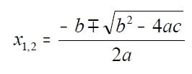
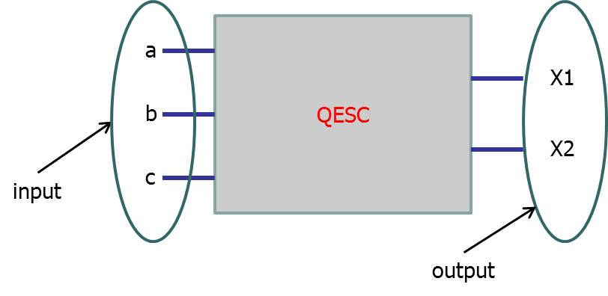
Abstraction Level: System
At system level a circuit is described in terms of its behavior:
an entity that performs a specific operation
we don’t know how the entity is inside
E.g. Quadratic Equation Solver Circuit:

Slide 16
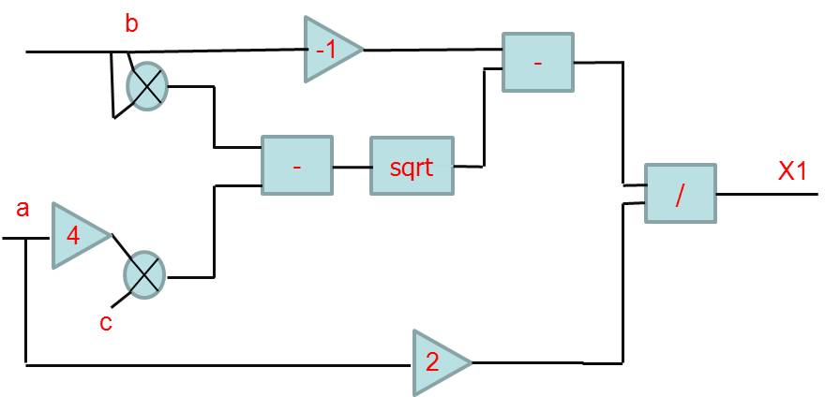
Abstraction Level: Module
At module level a circuit is described as a connection of modules performing specific operations:

Slide 17
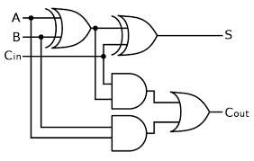
Abstraction Level: Gates
At gate level a circuit is described in terms logic gates.
Each module is composed by logic gates.
Adder

Slide 18
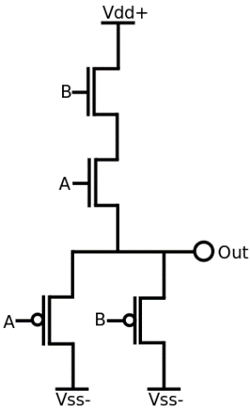
Abstraction Level: Transistor
At transistor level a circuit is described in terms transistor.
Each logic gate is composed by transistors.

Slide 19
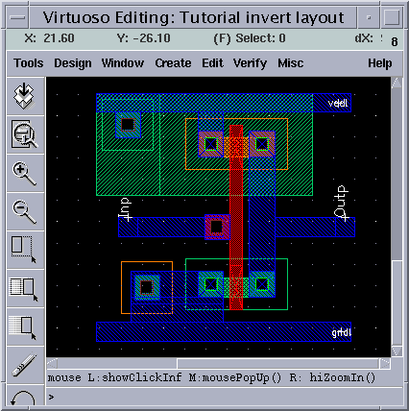
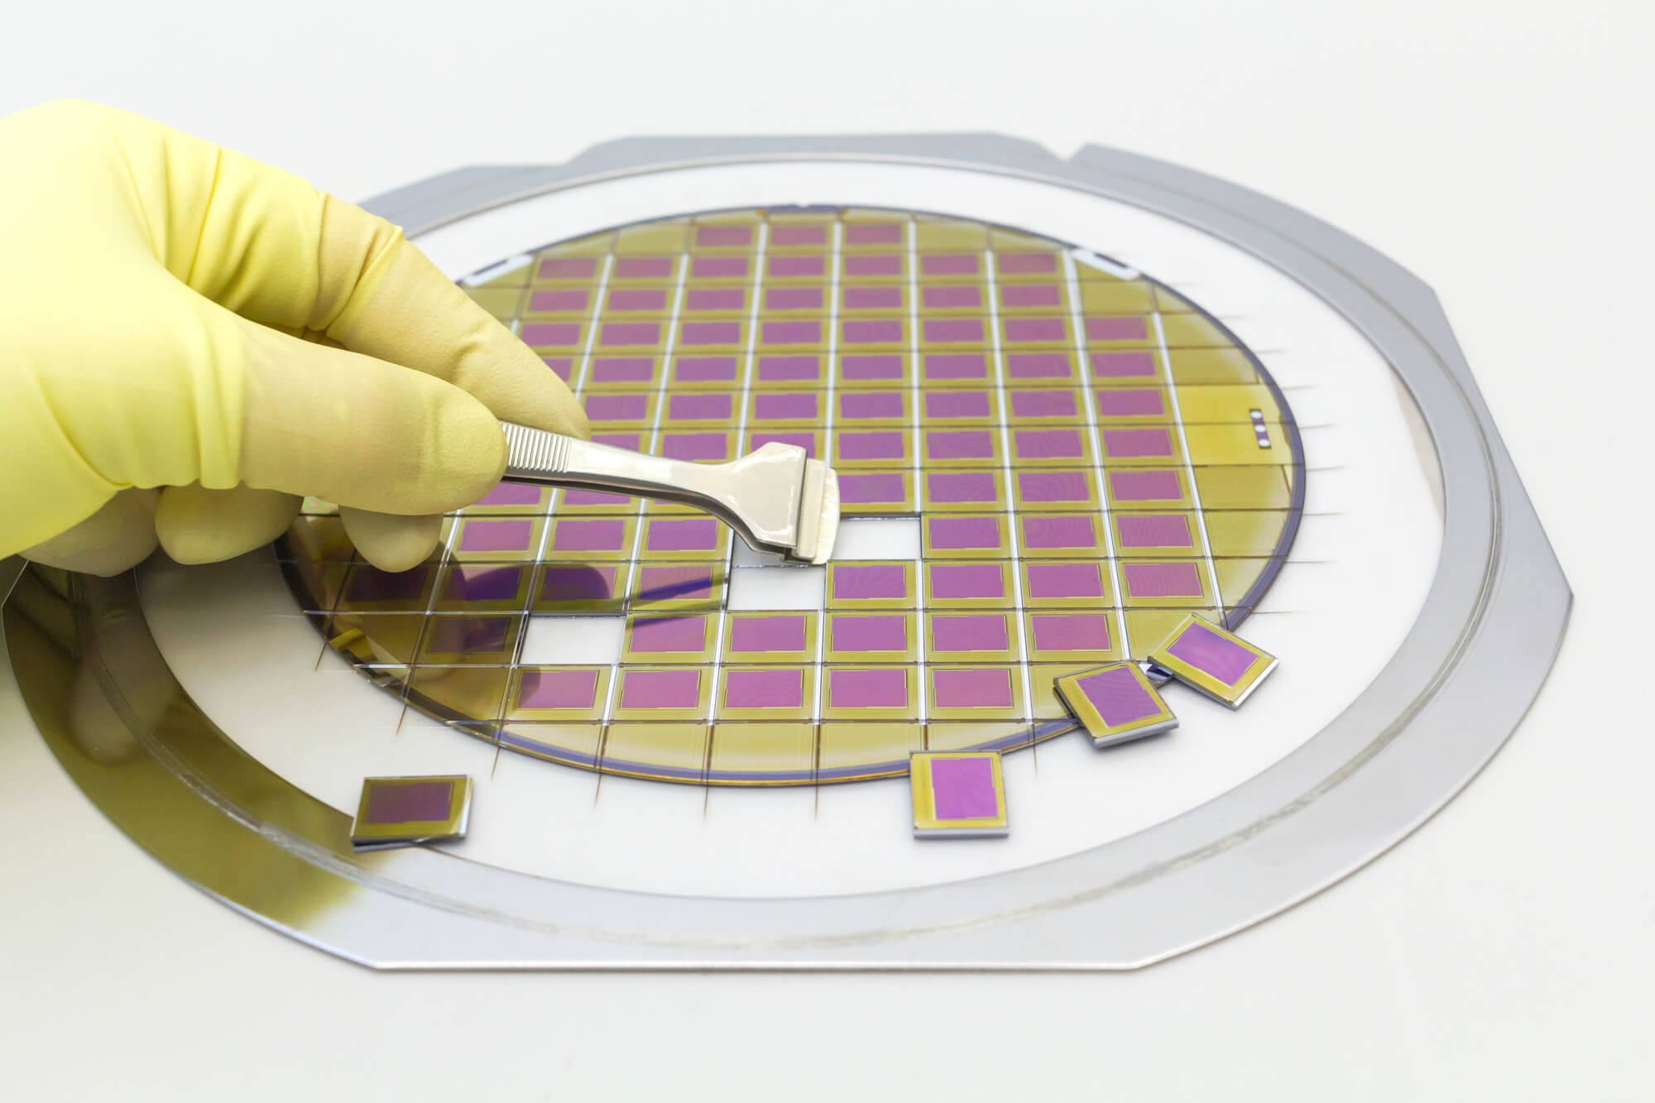
Abstraction Level: Silicon
At silicon layer a circuit is described in terms semiconductors.
Transistors are composed by semiconductors.

Slide 20
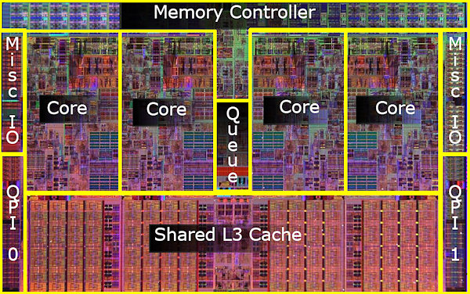
Silicon example
Intel i7 processor
731.000.000 transistor in 263 mm²

Slide 21
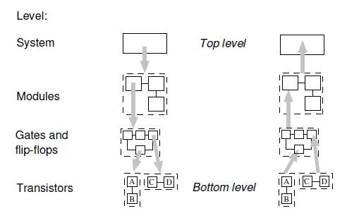
Abstraction Level: Top-down/Bottom up
Analysis can be performed using two different approaches
Top-down: circuit is analyzed from system level to transistor level.
Bottom-up: circuit is analyzed from transistor level to system level

Slide 22
Recap
In this lesson we analyzed the basic concepts of digital systems.
An analog signal can be digitalized by the analog to digital conversion process.
Digital systems can be classified in:
combinational systems;
sequential systems.
Digital systems can be analyzed and designed at different abstraction levels.

